Slide 1


Slide 2


Slide 3
let’s break down this JavaScript stuff….

Slide 4

Language,
API’s,
Frameworks

Slide 5


Slide 6


Lesson 1.
Sweet Beard →
JavaScript is for bearded men and hipsters.
JavaScript is everywhere.
JavaScript is fast, bat shit very fast.
Version 6 is coming.
… and, yes IE too.
JavaScript Ninja →

Slide 7

“Any application that can be written in JavaScript, will eventually be written in JavaScript.” – Jeff Atwood

Slide 8
wait, they don’t have beards…

Slide 9
a few examples:
browser(s)
node.js
PhoneGap
Windows 8

Slide 10
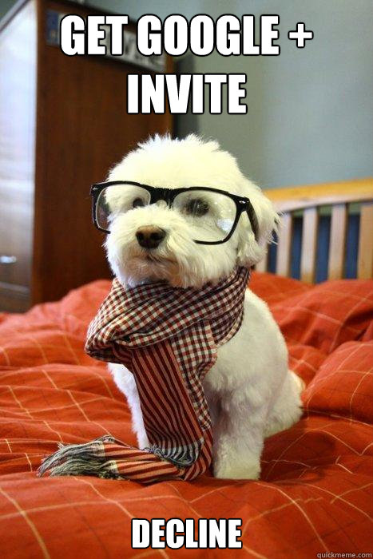
Lesson 2.
Get with ECMA Script 5 already….
ECMA Script 6,,,, is in the works.

Slide 11

“use strict”;

Slide 12
(function () {
"use strict";
WAT = “insert bad boy here";
})();

Slide 13


Slide 14
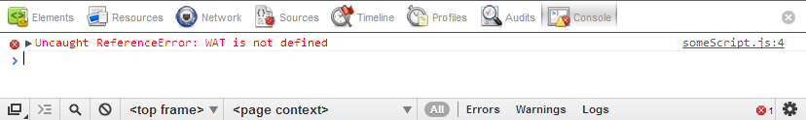

Slide 15
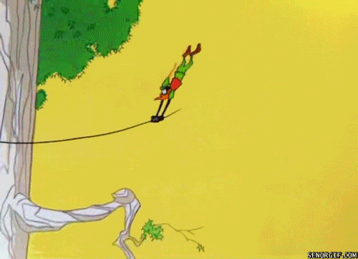

Slide 16
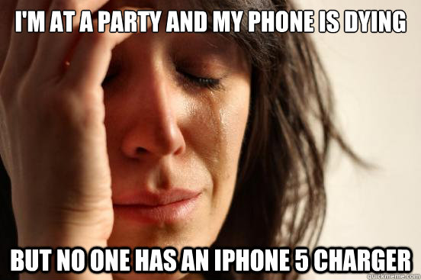

Slide 17
that’s actually not a JavaScript problem.

Slide 18
JavaScript is more than… $(‘#do’).hide();

Slide 19
wait, that was jQuery. writing jQuery != writing JavaScript

Slide 20
“ JavaScript is a language that most people don’t bother to learn before they use.
Most people feel like they should be able to program in JavaScript without any knowledge at all”
- Douglas Crockford

Slide 21
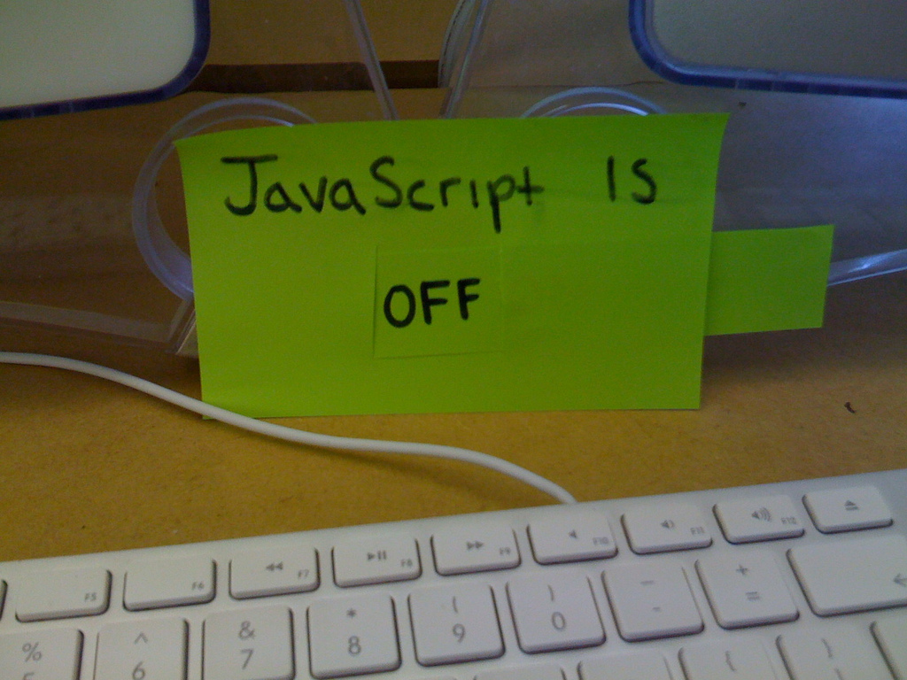
learn JavaScript as a language, not some “script“.

Slide 22
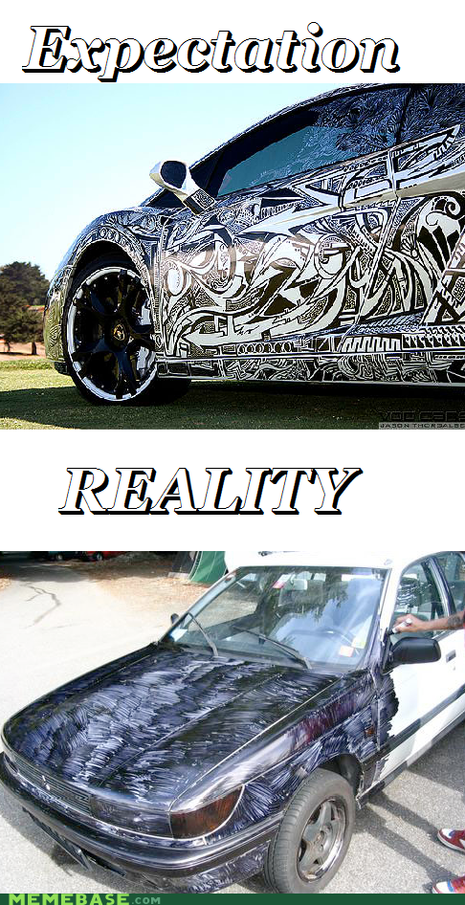

Slide 23
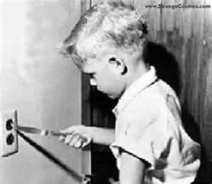
APIs

Slide 24
There’s an API for that.
Geolocation
IndexDB
JSON
Web Sockets
Web Workers
Storage
Cache
File Access
Drag and Drop
XHR L2
… to name a few
maybe…
http://caniuse.com/

Slide 25





Feature Detection!

Slide 26


Slide 27
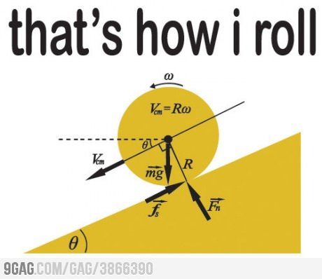
Modernizr,
Script Loaders
http://modernizr.com/
http://yepnopejs.com/

Slide 28
Modernizr.load({
test: Modernizr.input.placeholder,
nope: "../js/html5placeholder.jquery.min.js",
callback: function() {
$('input[placeholder]').placeholder();
}
});

Slide 29

Frameworks

Slide 30
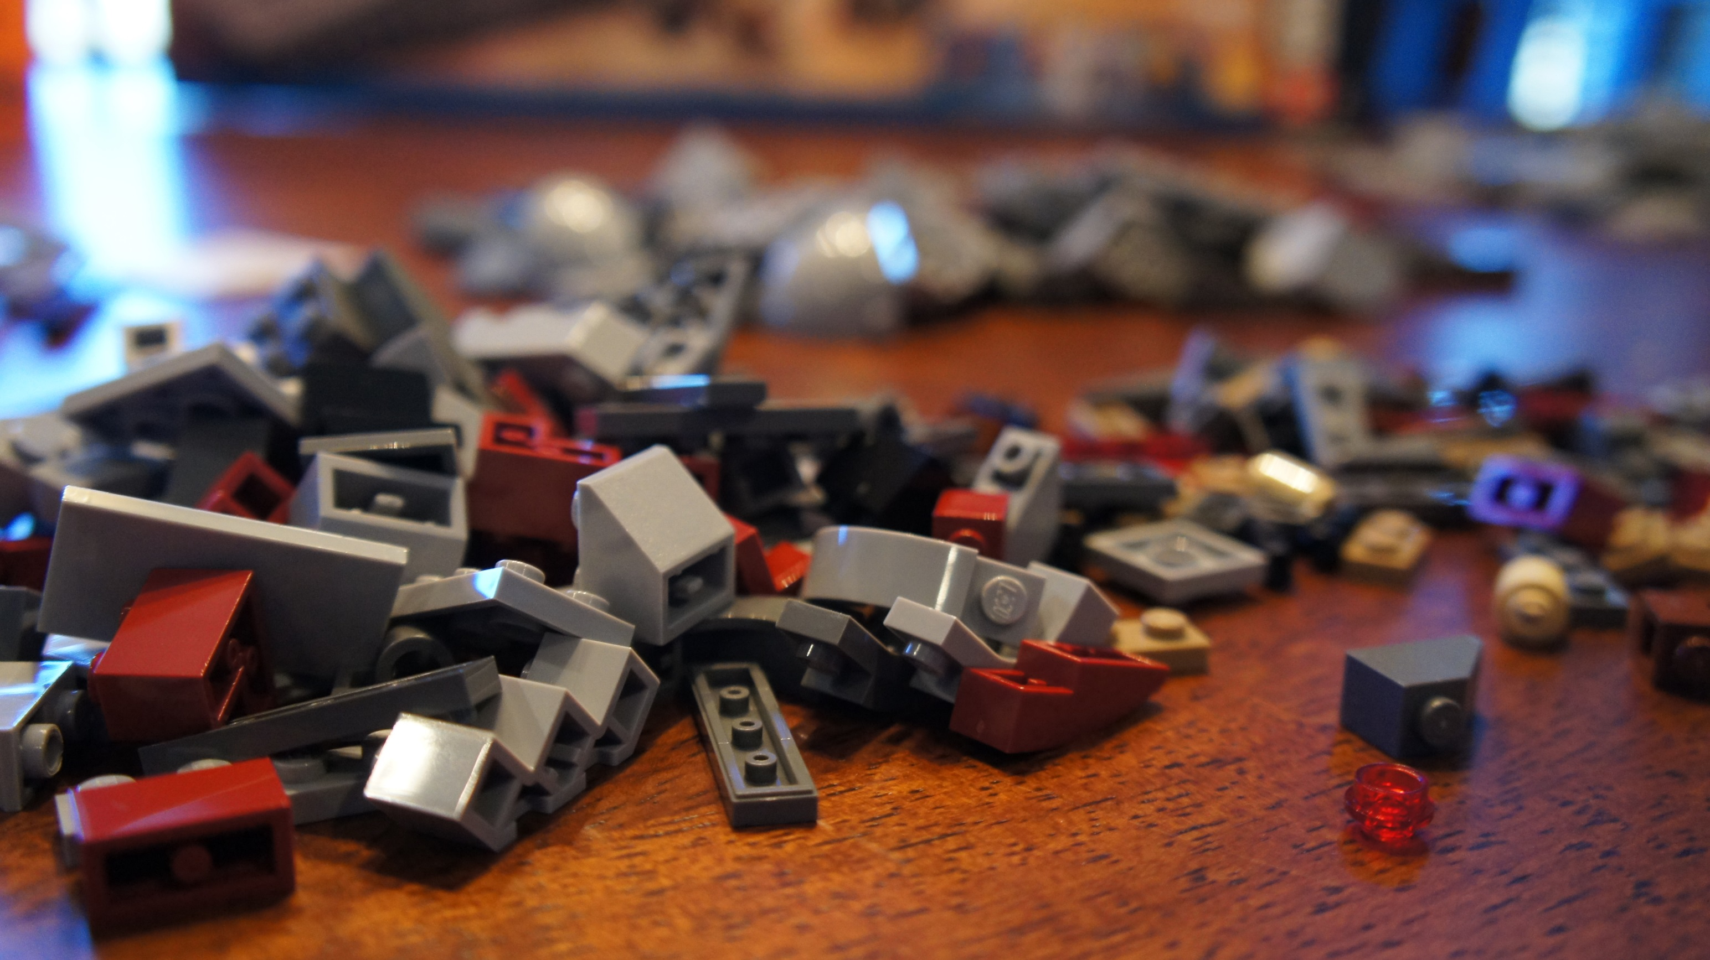
<head>
<script src=“…”></script>
<script src=“…”></script>
<script src=“…”></script>
<script src=“…”></script>
<script src=“…”></script>
<script src=“…”></script>
<script src=“…”></script>
<script src=“…”></script>
<script src=“…”></script>
<script src=“…”></script>
<script src=“…”></script>
<script src=“…”></script>
<head>
<script src=“…”></script>
<script src=“…”></script>
<script src=“…”></script>
<script src=“…”></script>

Slide 31
let’s break this one down….

Slide 32

The Clark Sell official list of not official framework categories, enterprise edition, service pack 1, release preview 2….

Slide 33

This is by no means meant to be an extensive list of JavaScript Frameworks, and it’s not comprehensive. I’m not making an explicit statement about anyone included or excluded. This is merely a list to provide you with an example. You need to do your own homework and validate all of the license agreements set forth by each of the various authors. I am personally very thankful for all of the hard work done by each of the respective product teams who participate in the open source community.

Slide 34
MVC Frameworks
UI Frameworks – cause we suck at UI
Make DOM Suck Less Frameworks
I don’t need it all now Frameworks - Loaders
CSS is painful sometimes frameworks - CSS
Language – everyone has an opinion.
Utility, Builds, Test, Developer oh my…

Slide 36






MVC Frameworks
Spine

Slide 37


UI Frameworks
Bootstrap

Slide 38




DOM Frameworks

Slide 39
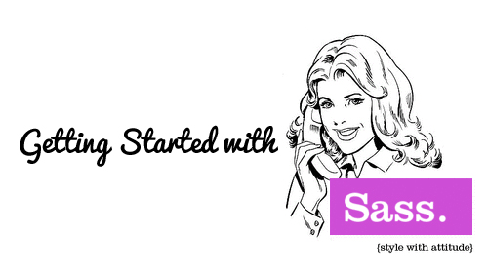

CSS Frameworks

Slide 40
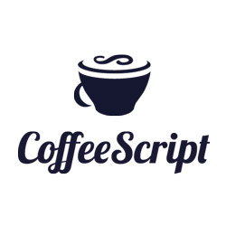

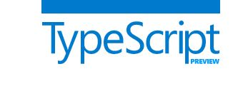
Language Frameworks

Slide 41
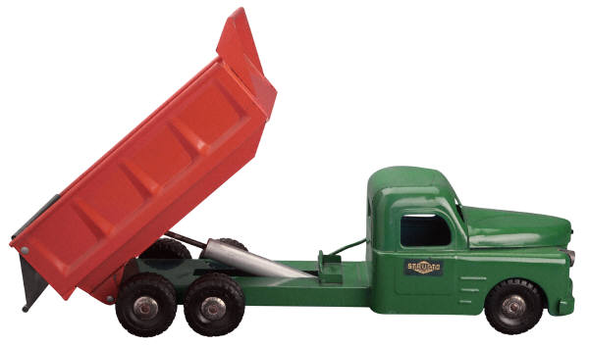
and wait, there is more…
Moment.js
Modernizer
YUI Compressor
require.js
yepnope.js
jsLint
jsHint
Jasmine
jUnit
qUnit
jsBin
jsFiddle
Underscore.js
Anvil.js

Slide 42
and that's just the free stuff…

Slide 44
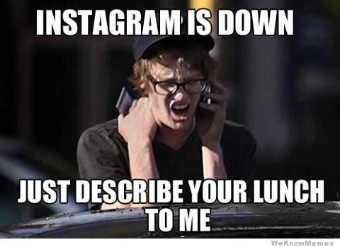

Slide 45
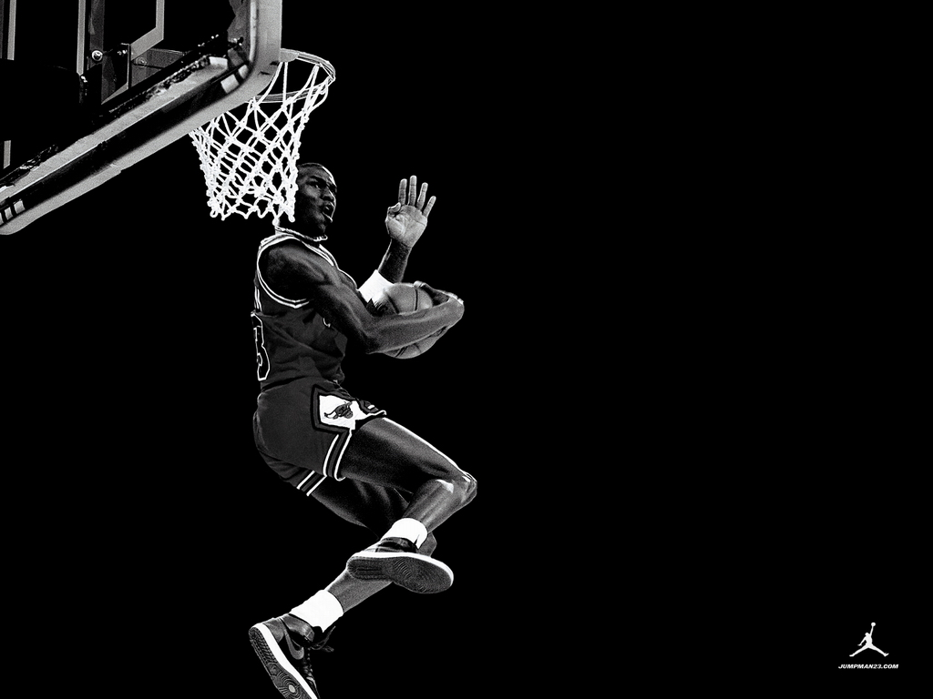
“I’ve missed more than 9000 shots in my career. I’ve lost almost 300 games. 26 times, I’ve been trusted to take the game winning shot and missed. I’ve failed over and over and over again in my life. And that is why I succeed.”
- Michael Jordan

